Slide 1
Function in python

Slide 2
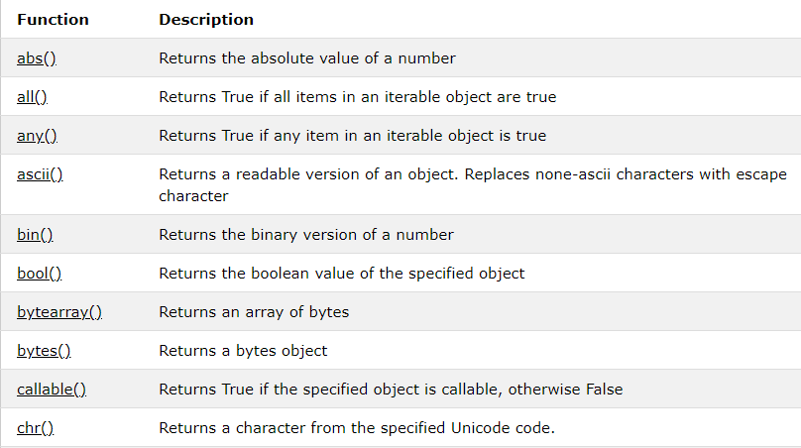
Types of Functions
Basically, we can divide functions into the following two types:
Built-in functions - Functions that are built into Python. Ex: print
The Python built-in functions are defined as the functions whose functionality is pre-defined in Python. The python interpreter has several functions that are always present for use.

Slide 3
User-defined functions
Functions defined by the users themselves.
A function is a block of organized, reusable code that is used to perform a single, related action. Functions provide better modularity for your application and a high degree of code reusing.
1. non-parametric 2. parametric
def functionname( parameters ):
"function_docstring"
function_suite
return [expression]
Calling a Function
Once we have defined a function, we can call it from another function, program or even the Python prompt. To call a function we simply type the function name with appropriate parameters.

Slide 4
Above shown is a function definition that consists of the following components.
Keyword def that marks the start of the function header.
A function name to uniquely identify the function.
Parameters (arguments) through which we pass values to a function. They are optional.
A colon (:) to mark the end of the function header.
One or more valid python statements that make up the function body. Statements must have the same indentation level (usually 4 spaces).
The return statement is used to exit a function and go back to the place from where it was called.

Slide 5
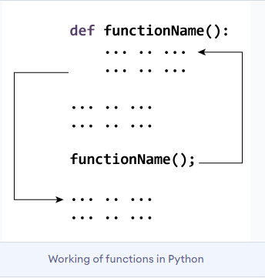
Pass by reference vs value
All parameters (arguments) in the Python language are passed by reference. It means if you change what a parameter refers to within a function, the change also reflects back in the calling function.

Slide 6
*agrs
*agrs is pass a non-keyworded, variable-length argument list
The syntax is to use the symbol * to take in a variable number of arguments; by convention, it is often used with the word args
With *args, any number of extra arguments can be tacked on to your current formal parameters
For example : we want to make a multiply function that takes any number of arguments and able to multiply them all together. It can be done using *args

Slide 7
*kwagrs
*kwagrs is pass a keyworded, variable-length argument list
A keyword argument is where you provide a name to the variable as you pass it into the function
One can think of the kwargs as being a dictionary that maps each keyword to the value that we pass alongside it. That is why when we iterate over the kwargs there doesn’t seem to be any order in which they were printed out.
Python can accept multiple keyword arguments, better known as **kwargs. It behaves similarly to *args, but stores the arguments in a dictionary instead of tuples.

Slide 8
Advantages of using functions
Keeps the program organized, easy to understand and makes it usable
Reduce redundancy
enhance readability of the program
Can be tested individually

Slide 9
Scope and Lifetime of variables
Scope of a variable is the portion of a program where the variable is recognized. Parameters and variables defined inside a function are not visible from outside the function. Hence, they have a local scope.
Global Variables
In Python, a variable declared outside of the function or in global scope is known as a global variable. This means that a global variable can be accessed inside or outside of the function.
Variables that are defined inside a function body have a local scope, and those defined outside have a global scope.

Slide 10
# WAF to reverse a string.
# WAF to swap two numbers.
# WAF to sort given list.
#WAF to find factorial of a number.
# WAF to design calculator program using function.

